Slide 1
TB WGS Workflow

Slide 2
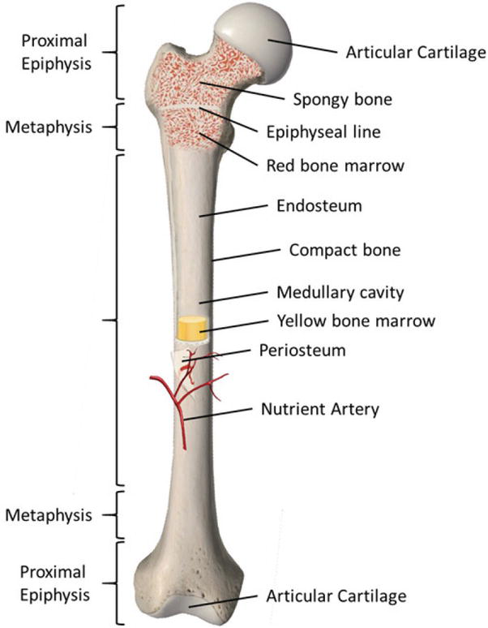
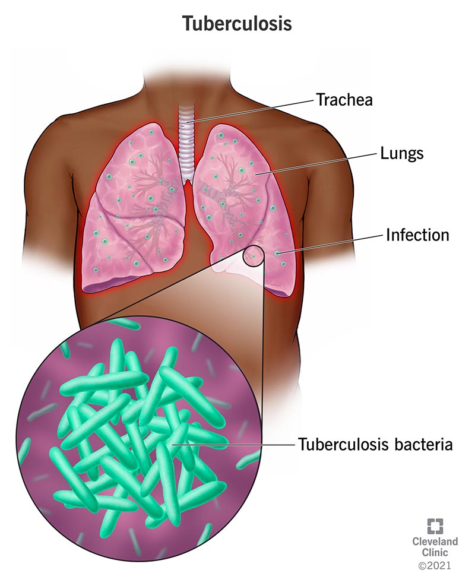
Active Pulmonary TB
Dormant TB

Slide 3
Green: rpoA gene; Yellow: rpoC gene; Red: rpoB gene; Black: xyz genes

Slide 4
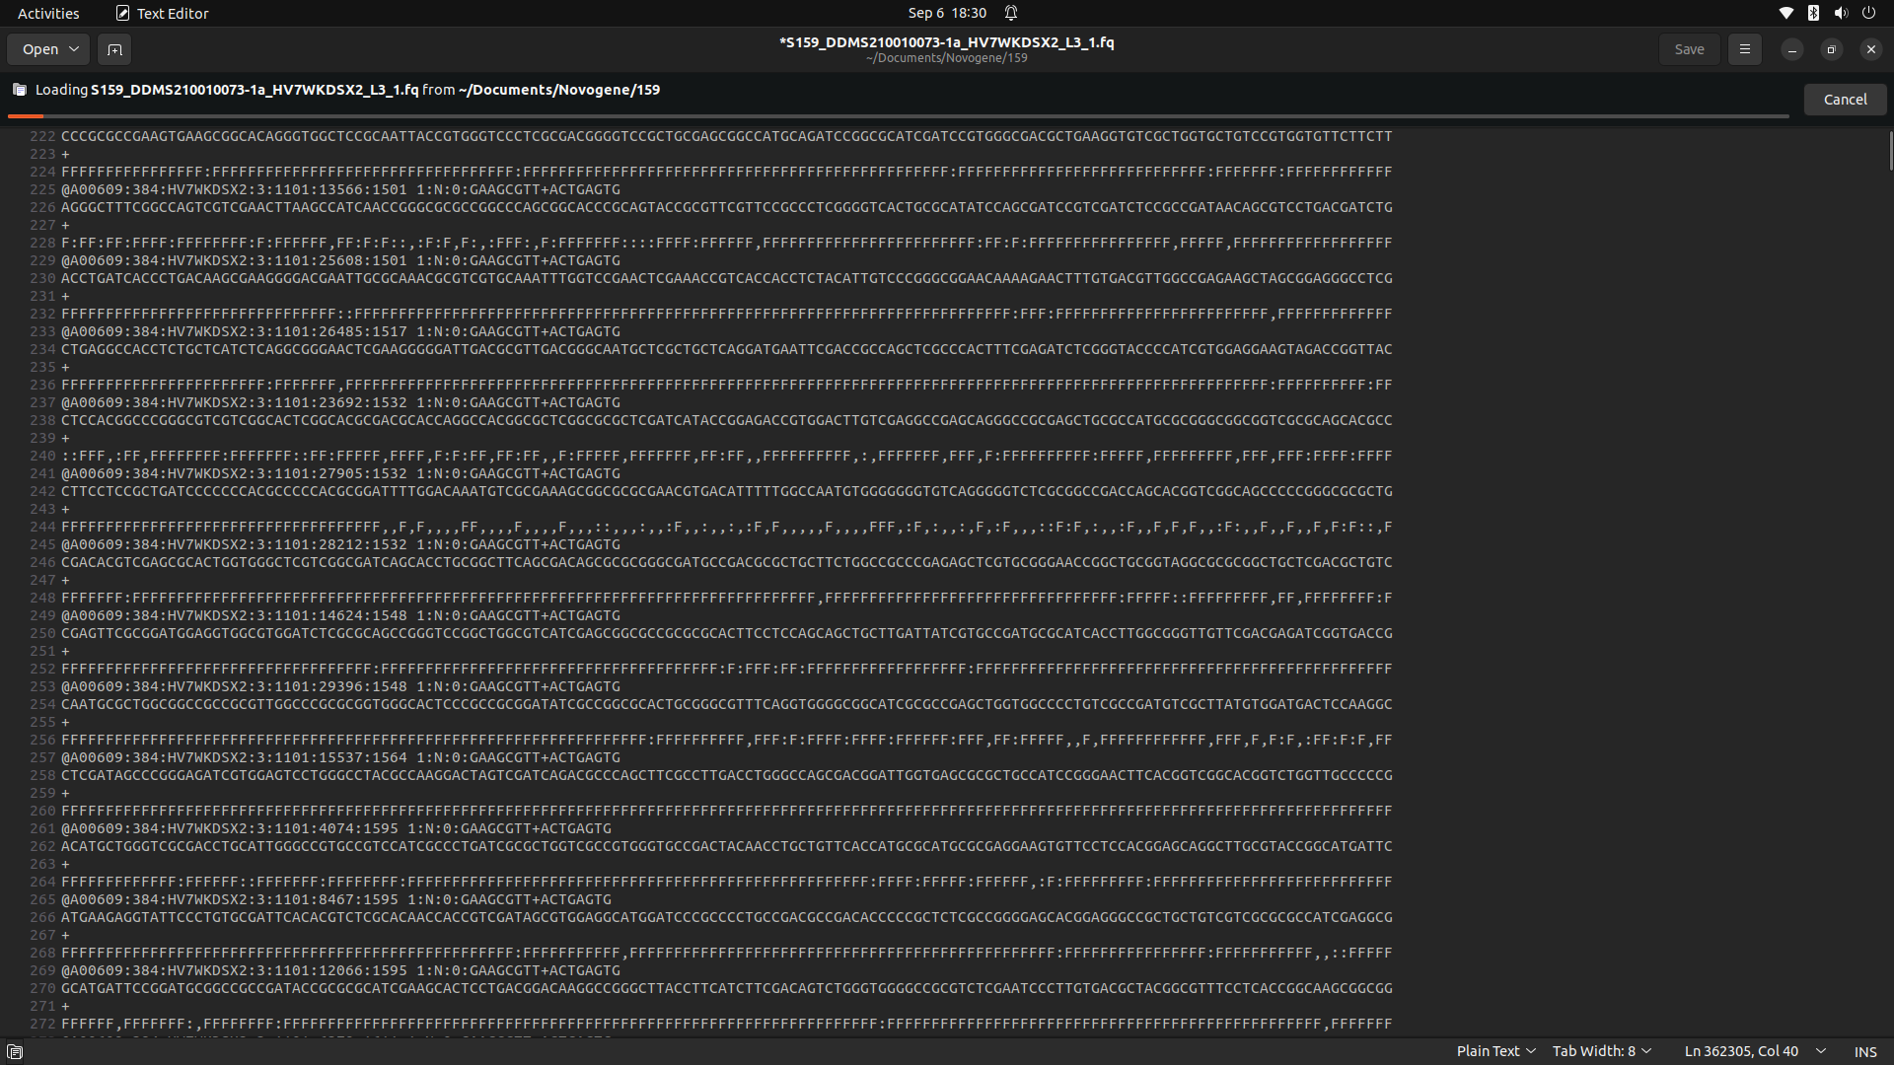
WGS Raw Data

Slide 5
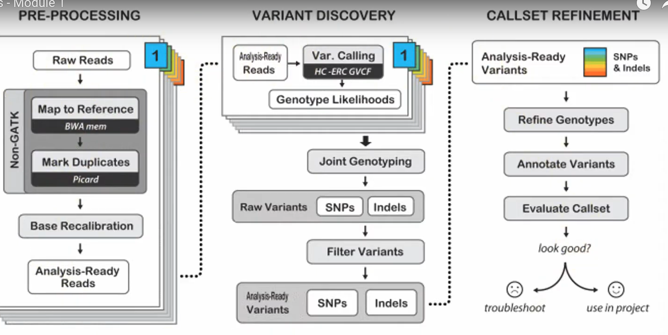
WGS Data Processing Pipeline

Slide 6
WGS Analysis tools
Quality control- FastQC
Trimming- Trimmomatic; CutAdapt
Mapping/Alignment: BWA
Variant Calling: GATK; SAMtools
Annotation: Annovar; SNPeff
Phylogenetic analysis: IQ-TREE; BEAST; FASTTREE

